Slide 1
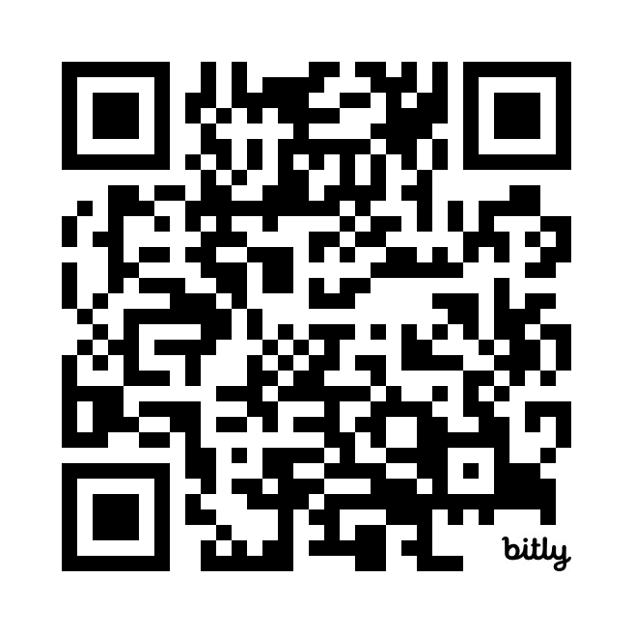
User Requirements Quiz
https://bit.ly/3vgyJ5j

